Slide 1
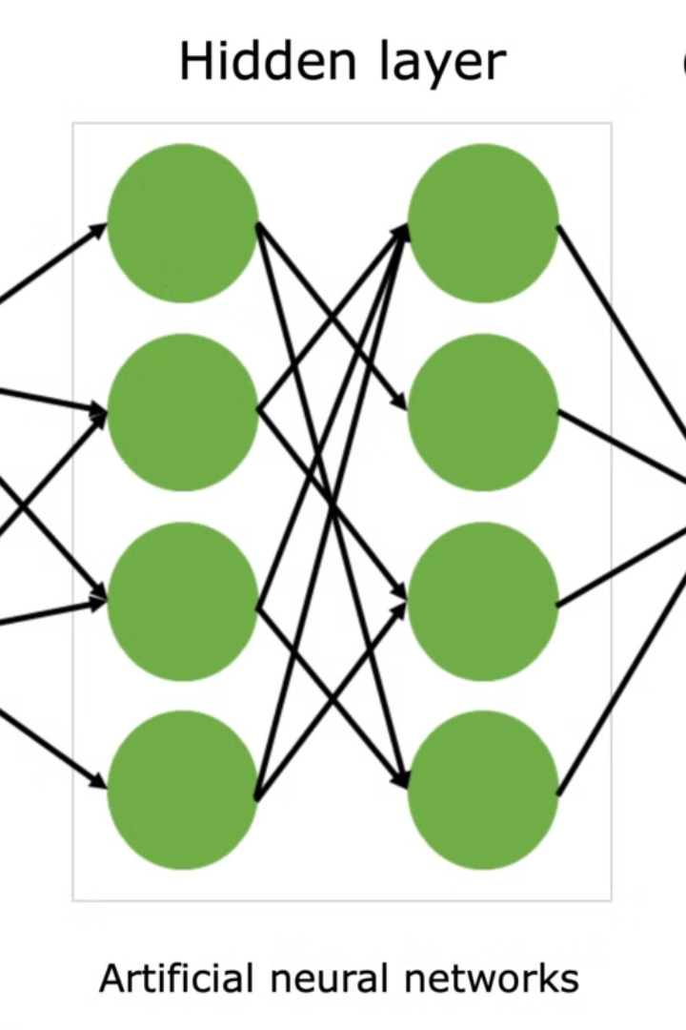
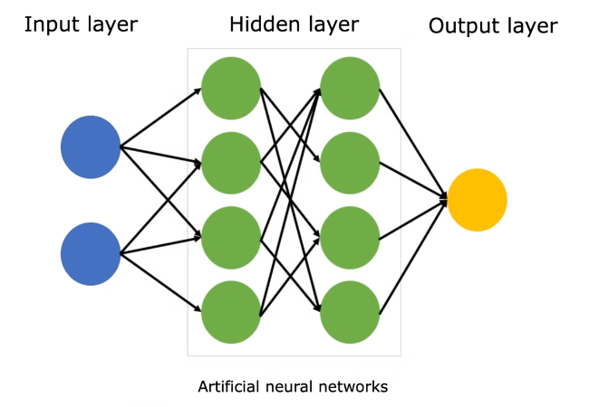
Introduction to Neural Networks
Neural networks are a powerful machine learning technique inspired by the structure and function of the human brain. They are composed of interconnected nodes, or "neurons," that work together to process and learn from data, enabling computers to perform complex tasks like image recognition, natural language processing, and predictive modeling.
At the core of a neural network are layers of neurons that receive inputs, perform mathematical operations, and pass the results to subsequent layers. As the network is exposed to large datasets, it can learn to identify patterns and make accurate predictions without being explicitly programmed. This ability to learn and adapt makes neural networks particularly well-suited for tackling real-world problems that are difficult to solve with traditional algorithms.

Slide 2
Fundamentals of Machine Learning
Data Acquisition and Preprocessing
Model Selection and Training
The foundation of any successful machine learning model lies in the quality and quantity of the data used to train it. Data acquisition involves gathering relevant data from various sources, while preprocessing entails cleaning, formatting, and transforming the data to make it suitable for the learning algorithms. This crucial step ensures the accuracy and reliability of the model's predictions.
With the data in hand, the next step is to select the appropriate machine learning algorithm for the problem at hand. This involves understanding the different types of algorithms, such as supervised, unsupervised, and reinforcement learning, and their respective strengths and weaknesses. Once the model is selected, it is trained on the preprocessed data, allowing it to learn the underlying patterns and relationships.
Model Evaluation and Validation
Deployment and Monitoring
After training, the model's performance must be evaluated to ensure it is accurate and reliable. This process involves using various metrics, such as accuracy, precision, recall, and F1-score, to measure the model's performance on a held-out validation set. If the model's performance is not satisfactory, the process may need to be repeated with different algorithms, hyperparameters, or data.
Once the model has been trained and validated, it can be deployed in a real-world scenario. This step involves integrating the model into a production environment, where it can be used to make predictions on new data. Continuous monitoring is essential to ensure the model's performance remains consistent over time, and necessary adjustments can be made to maintain its accuracy and reliability.

Slide 3
Supervised Learning Algorithms
Supervised learning is a fundamental approach in machine learning where the algorithm is trained on a labeled dataset, meaning the input data has corresponding target outputs or labels. The goal is for the model to learn patterns and relationships within the data in order to make accurate predictions on new, unseen data. Some of the most widely used supervised learning algorithms include:
Linear Regression - Used to predict a continuous numerical output based on one or more input features. It finds the linear relationship between the inputs and output.
Logistic Regression - Utilized for binary classification tasks, where the output is a categorical value such as 'true' or 'false', 'spam' or 'not spam'. It models the probability of the output belonging to a particular class.
Decision Trees - A tree-like model that makes decisions based on a series of feature-based rules. It recursively partitions the data to find the most informative features that lead to accurate predictions.
Support Vector Machines (SVMs) - A powerful algorithm that can perform both classification and regression tasks. It finds the optimal hyperplane that best separates different classes of data with the largest margin.
K-Nearest Neighbors (KNN) - A non-parametric method that classifies new data points based on the labels of the K closest training examples in the feature space.
These algorithms each have their own strengths, weaknesses, and use cases, and are frequently used as starting points for many supervised learning problems. The choice of algorithm depends on factors like the size and complexity of the dataset, the nature of the problem (regression or classification), and the level of interpretability required.

Slide 4
Unsupervised Learning Algorithms
Unsupervised learning is a powerful technique in machine learning that allows algorithms to identify hidden patterns and structures in data without the need for labeled or pre-defined outcomes. These algorithms are particularly useful when working with large, complex datasets where the relationships between variables are not well-understood. By leveraging unsupervised methods, researchers and data scientists can uncover insights and discover new knowledge that may be difficult to detect through more traditional, supervised approaches.
Some of the most commonly used unsupervised learning algorithms include k-means clustering, which groups data points into distinct clusters based on their similarity; principal component analysis (PCA), which identifies the most important features or dimensions that explain the majority of the variance in a dataset; and self-organizing maps (SOMs), which create a low-dimensional, discretized representation of the input space, allowing for the visualization and exploration of complex, high-dimensional data.
These algorithms have a wide range of applications, from customer segmentation in marketing to anomaly detection in cybersecurity, and from image recognition to natural language processing. By uncovering hidden patterns and relationships, unsupervised learning can provide valuable insights that can drive innovation, improve decision-making, and lead to new discoveries across a variety of industries and domains.

Slide 5
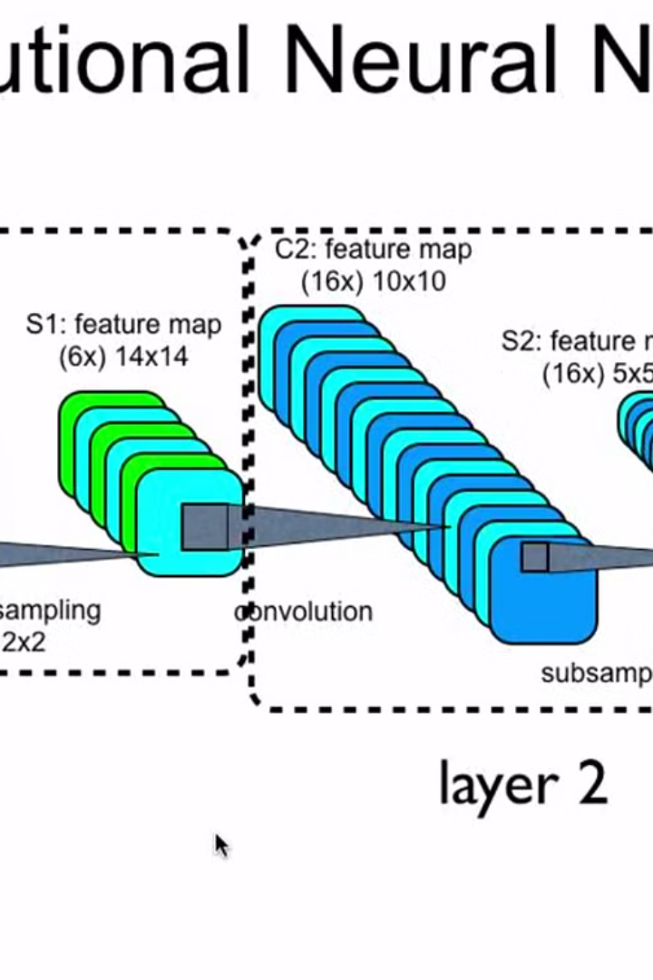
Convolutional Neural Networks
Convolutional Neural Networks (CNNs) are a powerful type of deep learning architecture that have revolutionized the field of computer vision. Unlike traditional neural networks that operate on flat, one-dimensional inputs, CNNs are designed to effectively process two-dimensional image data by leveraging the spatial and local dependencies within the input.
The core components of a CNN include convolutional layers, pooling layers, and fully connected layers. The convolutional layers apply a set of learnable filters to the input image, extracting local features such as edges, shapes, and textures. The pooling layers then downsample the feature maps, reducing the spatial dimensions and extracting the most salient features. Finally, the fully connected layers combine these high-level features to make the final predictions, such as image classification or object detection.
One of the key advantages of CNNs is their ability to learn hierarchical representations of the input data, where lower-level features are combined to form more complex, higher-level features. This architecture allows CNNs to effectively capture the intricate patterns and structures present in images, making them highly successful in a wide range of computer vision tasks, including image recognition, object detection, semantic segmentation, and more.

Slide 6
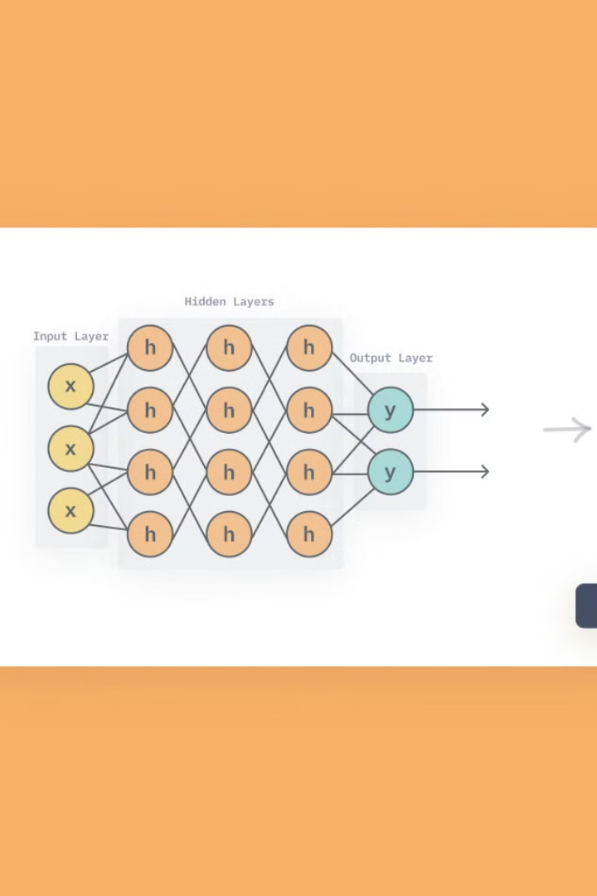
Recurrent Neural Networks
Recurrent Neural Networks (RNNs) are a powerful class of neural networks that are specifically designed to handle sequential data, such as text, speech, and time series. Unlike traditional feedforward neural networks, RNNs have a unique ability to maintain a hidden state that allows them to capture the dynamic relationships within a sequence. This makes them particularly useful for tasks like language modeling, machine translation, and speech recognition, where the order and context of the input data are crucial.
The key feature of RNNs is their recurrent connections, which allow the network to process input data one element at a time, while maintaining a hidden state that is updated at each time step. This hidden state acts as a memory, enabling the network to incorporate information from previous inputs into the current output. This allows RNNs to model complex, long-term dependencies in sequential data, which is a significant advantage over traditional feedforward networks.

Slide 7
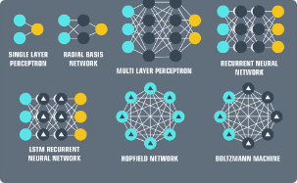
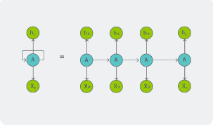
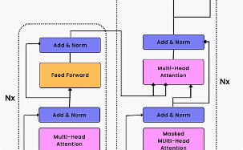
Deep Learning Architectures
Convolutional Neural Networks
Recurrent Neural Networks
Transformer Networks
Transformer networks are a recent deep learning architecture that have revolutionized the field of natural language processing (NLP). Inspired by the self-attention mechanism, Transformers do away with the traditional sequence-to-sequence models and instead rely on an encoder-decoder structure that allows for more efficient and parallel processing of input sequences. This architecture has proven to be highly effective in a wide range of NLP tasks, including language translation, text generation, and question answering. Transformers' ability to capture long-range dependencies and learn contextual representations has made them the go-to choice for many state-of-the-art NLP models, such as BERT, GPT-3, and T5.
Convolutional Neural Networks (CNNs) are a powerful deep learning architecture that have revolutionized the field of computer vision. CNNs are inspired by the human visual system, with specialized layers that extract and learn hierarchical visual features from raw image data. Through a series of convolutional, pooling, and fully connected layers, CNNs can effectively recognize and classify objects, faces, scenes, and more. The local connectivity and weight sharing in CNNs make them highly efficient and scalable, allowing them to handle large and complex visual datasets with remarkable accuracy.
Recurrent Neural Networks (RNNs) are a class of deep learning models designed to handle sequential data, such as text, speech, and time series. Unlike feedforward neural networks, RNNs have internal memory that allows them to process inputs sequentially and understand the contextual relationships between elements. This makes RNNs particularly well-suited for tasks like language modeling, machine translation, and speech recognition. By incorporating feedback loops and maintaining hidden state representations, RNNs can effectively capture long-term dependencies in sequential data, enabling them to generate coherent and meaningful outputs.

Slide 8
Hyperparameter Tuning and Optimization
Learning Rate
Batch Size
Regularization
Optimization Algorithms
The learning rate is a crucial hyperparameter that determines the step size taken during the optimization process. It plays a significant role in the convergence and performance of your neural network. Setting the right learning rate can be challenging, as a rate that is too high may cause the model to diverge, while a rate that is too low can lead to slow convergence.
The batch size determines the number of samples passed through the network before the weights are updated. Larger batch sizes can lead to more stable gradients and faster convergence, but they also require more memory. Smaller batch sizes, on the other hand, can introduce more noise into the gradients, but they are more memory-efficient.
Regularization techniques, such as L1 and L2 regularization, are used to prevent overfitting and improve the generalization of your model. These hyperparameters control the amount of regularization applied to the weights, which can significantly impact the model's performance on both the training and validation/test sets.
The choice of optimization algorithm, such as Stochastic Gradient Descent (SGD), Adam, or RMSProp, can also have a significant impact on the performance of your neural network. Each algorithm has its own unique set of hyperparameters, such as momentum or adaptive learning rates, that need to be tuned to achieve optimal results.

Slide 9
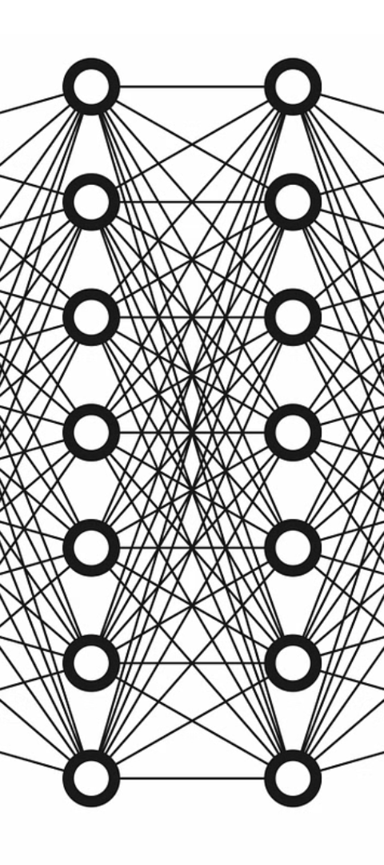
Applications of Neural Networks
1
Computer Vision
Neural networks have revolutionized the field of computer vision, Convolutional Neural Networks (CNNs), in particular, have become the dominant approach for tasks such as image classification, and image segmentation. These powerful algorithms can identify and classify objects, faces, and scenes with human-like precision, making them invaluable in applications ranging from self-driving cars and medical imaging to security and surveillance.
2
Natural Language Processing
Neural networks have also made significant advancements in the field of natural language processing (NLP). Recurrent Neural Networks (RNNs) and Transformers have enabled machines to understand, generate, and translate human language with remarkable accuracy. These models are used in a wide range of applications, including chatbots, language translation, text summarization, and sentiment analysis.
3
Speech Recognition
Neural networks have transformed the field of speech recognition, enabling machines to accurately transcribe and understand spoken language. Deep learning algorithms, such as Long Short-Term Memory (LSTM) networks, can process and interpret complex audio data, allowing for the development of advanced voice assistants, dictation software, and automated call centers.

Slide 10
Future Trends in Machine Learning
Continued Advancements in Deep Learning
Increased Specialization and Domain Adaptation
As computational power and data availability continue to grow, we can expect to see increasingly complex and powerful deep learning architectures emerge. These will allow for more accurate and nuanced modelling of real-world phenomena, leading to breakthroughs in areas like natural language processing, computer vision, and predictive analytics.
While general-purpose machine learning models have their place, the future will likely see a greater focus on domain-specific models that are tailored to the unique challenges and requirements of individual industries and applications. This specialization will drive better performance and more impactful real-world outcomes.
Explainable and Ethical AI
Increased Integration with Edge Devices
As machine learning systems become more sophisticated and widespread, there will be a growing demand for transparency and accountability. Explainable AI models that can provide insights into their decision-making processes will become essential, particularly in sensitive domains like healthcare and finance. Additionally, the development of ethical guidelines and principles for the responsible use of AI will be a key priority.
With the rise of the Internet of Things (IoT) and the proliferation of edge devices, machine learning models will increasingly be deployed closer to the point of data generation. This will enable real-time processing, reduced latency, and improved privacy and security, as sensitive data can be analyzed locally rather than being transmitted to central servers.

